Slide 1

Real World Evidence Using Measurement Values for Patient-Level Prediction Models: a Feasibility Study
Mentors:
James Gilbert
Jenna Reps
Anthony Sena
August 7, 2023
Xiaoyu (Elena) Wang
Observational Health Data Analytics Intern
Global Epidemiology Organization (GEO)
M.S. in Statistical Science, Duke University, Grad. May 2023​
GEO - Observational Health Data Analytics

Slide 2
Agenda
1
Introduction/Background
Methods
Results - Pre-investigation
Results - Models
Summary
Future Directions
2
3
4
5
GEO - Observational Health Data Analytics

Slide 3
Introduction/Background
The Observational Health Data Sciences and Informatics (OHDSI) Patient-Level-Prediction (PLP) framework and observational medical outcomes partnership (OMOP) common data model (CDM) support crafting of PLP models from observational healthcare data to augment real world evidence (RWE).
Challenges arise when incorporating measurements into these models due to:
Non-standardization in the OMOP data model - varying and unknown units.
Sparse recording of measurements due to the observational nature of data leading to missing data.
Feasibility of including measurements in models could be explored by:
Standardizing certain data manually on a per-measurement basis.
Leveraging Bayesian Inference for the coherent modeling of missing values.
Current research initiates the exploration of this feasibility by large observational healthcare data.
GEO - Observational Health Data Analytics

Slide 4
Methods Predict Future Ischemic Stroke Events amongst Patients with Atrial Fibrillation (AFib) in 1yr after AFib diagnosis
Benchmark Models: Utilized Patient-Level-Prediction to fit two standard models using LASSO logistic regression and GBM, incorporating age groups, sex, drugs, and conditions in the prior 365 days.
Measurement-Integrated Models: Developed models incorporating 21 standard measurements along with age groups, sex, drugs, and conditions from the past year using LASSO logistic regression and GBM, standardizing each measurement and imputing average value where data was absent.
Bayesian Approach: Utilized Bayesian Sparse Regression as a potential alternative to traditional regression and imputation methods, addressing challenges of non-standardization and data sparseness.
GEO - Observational Health Data Analytics

Slide 5
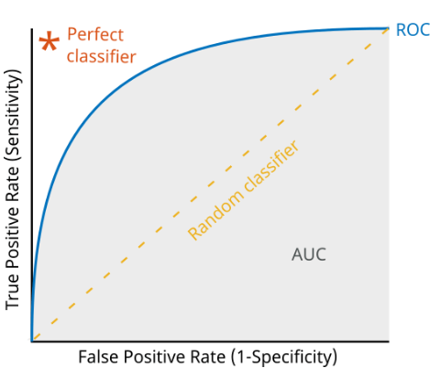
Methods Predict Future Ischemic Stroke Events amongst Patients with Atrial Fibrillation (AFib) in 1yr after AFib diagnosis
Performance Metrics:
Area Under the Receiver Operating Characteristic Curve (AUC-ROC):
ROC plot shows how well a model can classify true positives and true negatives.
The AUC score quantifies this by ranging from 0.5 (no better than random guessing) to 1 (perfect classification).
Other Techniques (please see more details in the poster and GitHub):
calibration in the large, net benefit, integrated discrimination improvement, and net reclassification improvement, maintaining consistent test/train split.
GEO - Observational Health Data Analytics

Slide 6
Methods Predict Future Ischemic Stroke Events amongst Patients with Atrial Fibrillation (AFib) in 1yr after AFib diagnosis
Lasso Logistic Regression
Logistic Regression: Predict binary outcomes
Example: Predict if patient has ischemic stroke or not
Lasso Regression: Select the most important features
Penalty shrinks the less important feature's coefficient to zero
Benefits of Lasso Logistic Regression:
Simplicity
Avoid Overfitting
Improve Accuracy
Gradient Boosting Machines (GBM)
A powerful ensemble machine learning method that works on the principle of boosting weak learners (decision trees) to form a strong predictive model.
Benefits of GBM:
Efficiency
Avoid Overfitting
Improve Accuracy
Flexibility
GEO - Observational Health Data Analytics

Slide 7
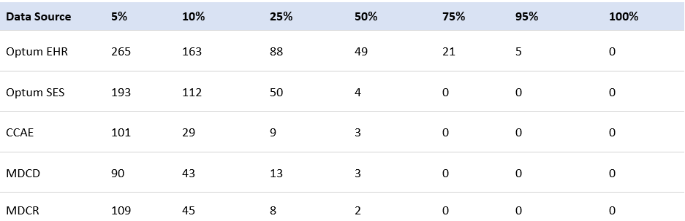
Results Pre-investigation
Table 1. Number of databases with measurements taken for at least x% of patients in the target population (patients treated for newly diagnosed stroke)
Optum EHR: the most comprehensive coverage, recording 5 measurements for 95% or more of patients
Identified 21 measurements recorded in at least 75% of the Optum EHR target population and will be integrated for future feasibility study
Claims databases have lower coverage, lacking sufficient measurements for half or more of the patients
Only 38 measurements, including blood glucose, lipase, and iron, were recorded for at least 5% of the target population in all five databases
GEO - Observational Health Data Analytics

Slide 8
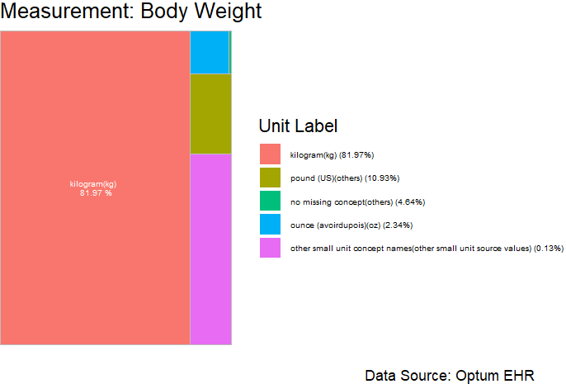
Results Pre-investigation
Figure 1. Frequency of units for measurement of body weight in Optum EHR.
Units that don’t map to standard measure concepts were merged into “No matching concept”.
GEO - Observational Health Data Analytics

Slide 9
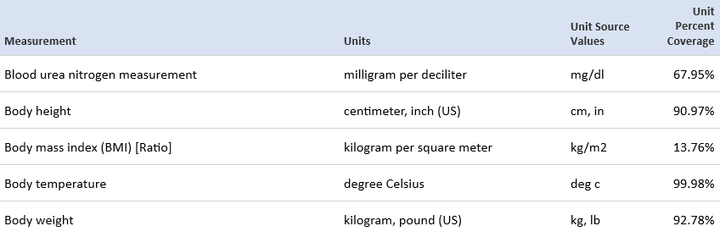
Results Pre-investigation
Can you see the issue for measurements? ☹
Table 2. Example measurement concepts and dominant units found with for at least 75% of patients for target population in Optum EHR.
The standard unit percentage:
the total coverage that map to vocabulary concepts
(and can therefore be mapped to a common unit).
GEO - Observational Health Data Analytics

Slide 10
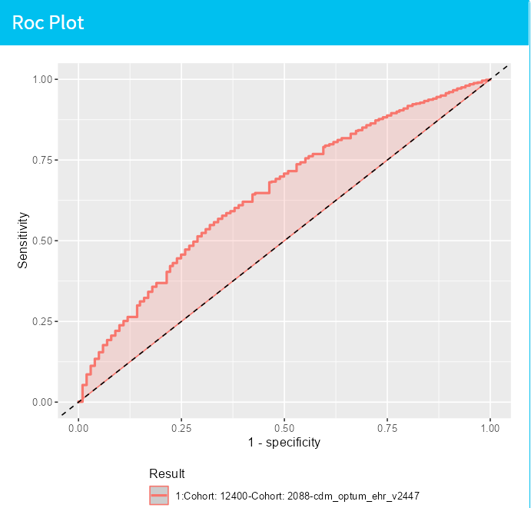

Results
Figure 2. Benchmark:
LASSO Regression Model Validation ROC Plot
AUCROC: 0.654 (0.644-0.67)
Figure 3. Measurement-Integrated:
LASSO Regression Model Validation ROC Plot
AUCROC: 0.652 (0.642-0.66)
Both methods were effective in differentiating health conditions, matching the established CHADs method.
LASSO demonstrated a good predictive accuracy across various probability thresholds.
GEO - Observational Health Data Analytics

Slide 11
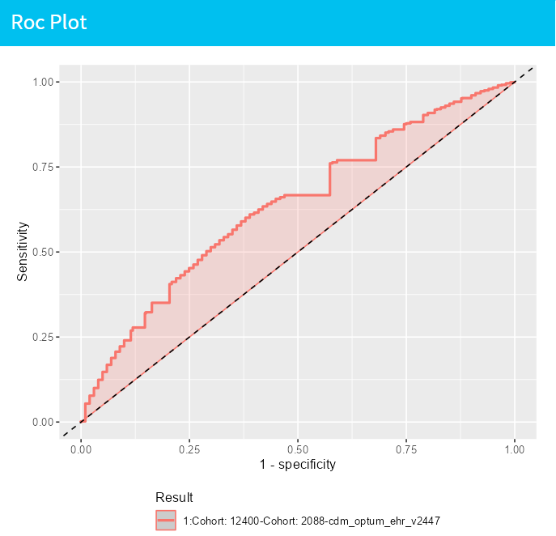
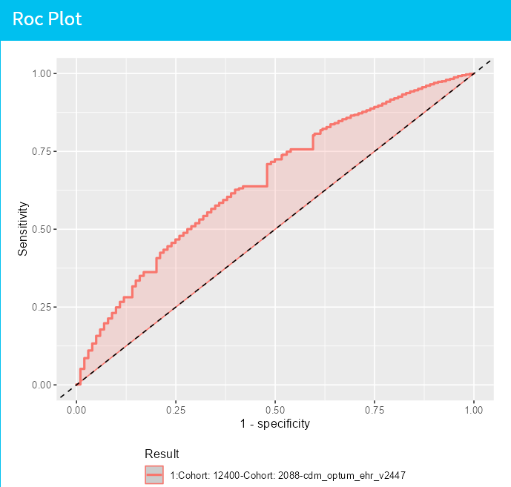
Results
Figure 4. Benchmark:
GBM Model Validation ROC Plot
AUCROC: 0.649 (0.638-0.66)
Figure 5. Measurement-Integrated:
GBM Model Validation ROC Plot
AUCROC: 0.663 (0.653-0.674)
Both indicated a good predictive accuracy that is consistent across various health conditions and patient characteristics.
Performance similarities were observed between the Benchmark and Measurement-Integrated models, with closely comparable AUCROC values for both LASSO and GBM.
Other evaluations signifies a similar level of prediction improvement and stability across models.
A potential for prediction improvements and stability with slight enhancement in GBM’s Measurement-Integrated models.
GEO - Observational Health Data Analytics

Slide 12
Summary
Preliminary analysis:
Five datasets revealed that >=50% of the target population lack sufficient recorded measurements in claims data, which might affect the prediction models and external validation.
Datasets often have inconsistent or missing units, necessitating manual standardization.
Optum EHR stands out as the most suitable for developing prediction models, as it allows the inclusion of 21 measurements that are present in >=75% of the target population.
Benchmark Models: Utilized Patient-Level Prediction to fit models using age, sex, drugs, and conditions from the past year, without considering measurements.
Measurement-Integrated Models: Developed models incorporating 21 standard measurements alongside age, sex, drugs, and conditions, standardizing and imputing missing data.
Both methods (Benchmark and Measurement-Integrated) were effective. LASSO Regression & GBM showed good predictive accuracy across various probability thresholds. Measurement-integrated models demonstrated potential for improvement and stability in predictions.
GEO - Observational Health Data Analytics

Slide 13
Future Directions
Explore and deepen the understanding of Bayesian methodologies to navigate challenges of non-standardization and data sparseness.
Improve data integration processes, such as utilizing natural language processing, to enhance measurements' data quality, potentially leading to better model development and prediction accuracy.
Rigorously calibrate and validate models on diverse patient populations to improve the generalizability and robustness of predictions.
Foster synergy between machine learning approaches and medical domain knowledge to refine predictive models.
Develop robust, accurate, and clinically applicable predictive models to assist healthcare professionals in informed decision-making.
GEO - Observational Health Data Analytics

Slide 14
Acknowledgements
Xiaoyu Wang^{1,2}, Jenna Reps^{1,3}, Anthony Sena^{1,3}, James P. Gilbert¹, Marc A Suchard^{4,5}
¹Janssen Research and Development, Titusville, NJ,
²Statistical Science Department, Duke University, Durham, NC,
³Department of Medical Informatics, Erasmus University Medical Center, Rotterdam, the Netherlands
⁴VA Informatics and Computing Infrastructure, US Department of Veterans Affairs, Salt Lake City, UT
⁵Department of Biostatistics, University of California, Los Angeles, CA
All the people who contributed to make this internship an amazing experience by their efforts, discussion, help from…​
Patrick Ryan
Christopher Knoll
Martijn Schuemie
Erica Voss
Joel Swerdel
Frank Defalco
Gowtham Rao
Nathan Hall
Julia Capperella
… and all others from GEO & OHDA fantastic team!
​
Big Thank You!
If you have any question or want to discuss more, Please contact @ ewang17@its.jnj.com ☺
GEO - Observational Health Data Analytics

Slide 15
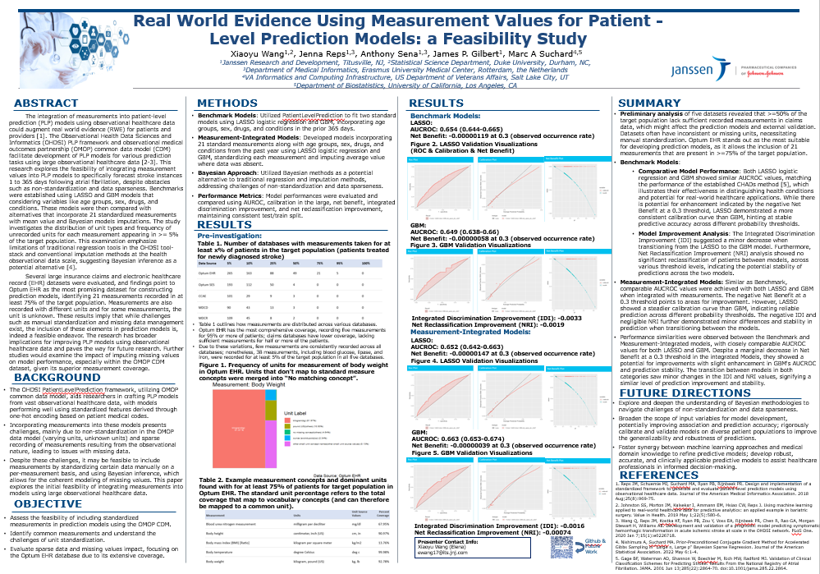
GEO - Observational Health Data Analytics

